Slide 1
eRTO System
Project Team – 5
Sanket Pansare
Pooja Kale
Prasad Chaudhari
Shubham Khodade

Slide 2
Purpose of project
The aim is to build a user-friendly webpage where the citizens can apply for learner’s license, driving license. The webpage also provides provision for citizens to submit their complaints.
Mainly, the website is used for issuing of license. An individual can apply for learning license and driving license online.
Accordingly, slots and dates are generated for the respective test. The application received will be verified and approved by the RTO officials.
The applicant can monitor the status of their application.

Slide 3
Need
eRTO System is introduce to optimize desk work.
Now a day’s many people are purchasing two wheelers, four wheelers etc. So the RTO employees having lot of work burden of maintaining documentation.
License issue, registration process etc. which required lot of paper work. As a result people cannot get the things done in right time, which waste the time, money & energy. Similarly the vehicle owner sometimes forgets to carry the documents at the time of enquiry. So to overcome these drawbacks we are developing an enhanced e-RTO System.
Such like that we provide one type of environment which gives a user friendly means user can access and understand well.
The proposed system is aimed to automate the major processes in the Regional Transport Office.

Slide 4
User Roles and Requirement
In our Web Application we have three types of user
Admin
Staff
Citizen

Slide 5
ADMIN
The super user, admin class represents complete authority over e-RTO Staff.
Admin has right to create account for staff.
The account created by admin will be accessed by staff only

Slide 6
STAFF
The e-RTO staff class represents complete authority over the system.
Staff has two list Permanent License List and Learning License List.
Staff perform two operation on List, Admin can either edit or delete.
Staff can change status of Learning License:
Pending Completed, , Applied For Permanent License
Similarly, staff can change status as Citizen for Permanent License:
Booked, Completed, Driving-Slot-Issued, Driving-Pass/Fail, Driving-Fail
Delete the Permanent or Learning License.

Slide 7
CITIZEN
Citizen has to register providing details as name, email, password.
Citizen has to Login as Citizen.
Apply for Learning and Permanent License providing details in brief.
Provide documents. (ex. Aadhar Card , Photograph, Signature)
Citizen can attend mock test.
Can check the status.

Slide 8
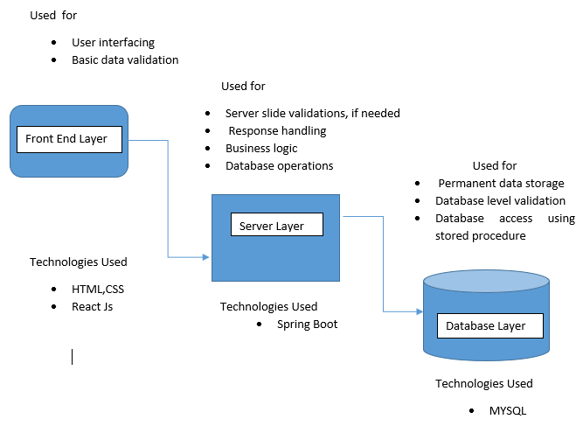
Project Architecture

Slide 9
Technology Platform used for Project
Technology used are :
Front End: React Js,HTML,CSS
Middle Tier: SpringBoot, Hibernate
Backend: MYSQL

Slide 10
Main reason to use React Js as a frontend technology are:
Makes JavaScript coding easier
Extremely competent
Excellent cross-platform support
Handles dependencies
Template designing made easy
Provides amazing developer tools
UI focused designs
Easy to adopt

Slide 11
Reasons to use SpringBoot
Fast and easy development of Spring-based applications;
It speeds up the development and deployment processes by using intuitive default settings for unit and integration tests.
The ability to create standalone applications;
Helping to directly embed Tomcat, Jetty, or Undertow into an application;
No need for XML configuration;
Reduced amounts of source code;
Additional out-of-the-box functionality;
Easy start;
Simple setup and management;
Large community and many training programs to facilitate the familiarization period.

Slide 12
Reason to use MySQL
Data Security
On-Demand Scalability
High Performance
Round-the-clock Uptime
Comprehensive Transactional Support
Complete Workflow Control
Reduced Total Cost of Ownership
The Flexibility of Open Source

Slide 13
Future Extension
As per Future Scope the mcq test for learning licence which is used to conduct in physical mode can also be conducted in online mode .
we can also include the feature of new vehicle registration .
The user can also apply for new fancy number

Slide 14
Conclusion
“RTO Management System” is aimed to automate the major processes in Regional Transport Offices. The scope of Online RTO Management system includes a complete suite of portal to provide citizens with 24/7 access to services like Online Registration for Learner's license & permanent license, Examination and maintaining results, Management of time slots for driving tests.
The main motive of the system is to make the daily activities efficient and providing fast response by storing and retrieving information & informing it to the users via SMS or E-Mail.

Slide 15
Thank you….!

